Slide 1
Difference Between C and Java
C | JAVA
C is a Procedural Programming Language. | Java is Object-Oriented language.
C generally breaks down into functions. | Java breaks down into Objects.
Memory allocation can be done by malloc in C. | Memory allocation can be done by a new keyword in Java.
C does not supports inheritance. | Java supports inheritance.
C is platform dependent. | Java is a platform independent.

Slide 2
Object-Oriented Programming (OOP)
Definition:
Object-oriented programming is a programming paradigm based on objects, which are instances of classes. It focuses on organizing code around data (attributes) and behavior (methods).
Key Features:
  Based on classes and objects.
  Follows a bottom-up approach.
  Supports encapsulation, inheritance, and polymorphism.
  Data and methods are bundled together in objects.
Example Languages: Java, Python, C++, C#
Example:
Think of a car as an object: It has data like color and model, and methods like start() or stop(). You can create many cars (objects) from the same design (class).

Slide 3
Everything is written as objects and classes in OOPs because for:
Encapsulation (security & structure)
Reusability (via inheritance)
Abstraction (modeling real-world)
Polymorphism (flexibility)
Modularity (easy maintenance)

Slide 4
Introduction to Java
Java is a high-level, robust, object-oriented, and secure programming language.
Java was developed by Sun Microsystems (which is now a subsidiary of Oracle) in the year 1995.
James Gosling is known as the father of Java. Before Java, its name was Oak. Since Oak was already a registered company, so James Gosling and his team changed the name from Oak to Java.

Slide 5
History of Java
James Gosling, Mike Sheridan, and Patrick Naughton initiated the Java language project in June 1991. The small team of sun engineers called Green Team.
Initially it was designed for small, embedded systems in electronic appliances like set-top boxes.
Firstly, it was called "Greentalk" by James Gosling, and the file extension was .gt.
After that, it was called Oak and was developed as a part of the Green project.

Slide 6
Oak is a symbol of strength and chosen as a national tree of many countries like the U.S.A., France, Germany, Romania, etc.
In 1995, Oak was renamed as "Java" because it was already a trademark by Oak Technologies.
Why had they chose the name Java for Java language?
The team gathered to choose a new name. The suggested words were "dynamic", "revolutionary", "Silk", "jolt", "DNA", etc. They wanted something that reflected the essence of the technology: revolutionary, dynamic, lively, cool, unique, and easy to spell, and fun to say.

Slide 7
Java is an island in Indonesia where the first coffee was produced (called Java coffee). It is a kind of espresso bean. Java name was chosen by James Gosling while having a cup of coffee nearby his office.
Note that Java is just a name, not an acronym.
Initially developed by James Gosling at Sun Microsystems (which is now a subsidiary of Oracle Corporation) and released in 1995.
In 1995, Time magazine called Java one of the Ten Best Products of 1995.

Slide 8
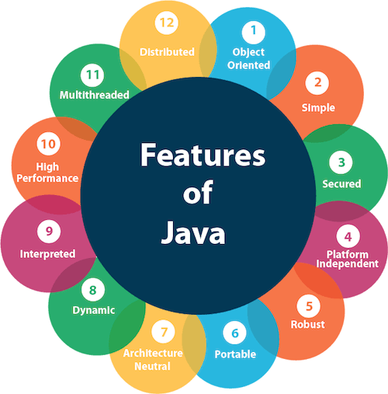
Features of Java

Slide 9
Simple
Java syntax is based on C++, making it easier for programmers to learn after C++.
Java has eliminated many complex and seldom-used features, such as explicit pointers and operator overloading.
There is no need to remove unreferenced objects because Java has Automatic Garbage Collection.

Slide 10
Object-Oriented
Java is an object-oriented programming language where everything is an object.
The basic concepts of OOP are:
Object
Class
Inheritance
Polymorphism
Abstraction
Encapsulation

Slide 11
Portable
Java's portability allows programs to run on various platforms without modification.
This is achievable because Java code is compiled into bytecode, which is independent of the underlying hardware and operating system. The JVM on each system interprets this bytecode, ensuring platform compatibility.
Write code once and run it anywhere.

Slide 12
Platform Independent
A platform refers to the hardware or software environment in which a program runs.
There are two types of platforms: software-based and hardware-based.
Java offers a software-based platform running on top of hardware-based platforms.
It consists of two components:
Runtime Environment
API (Application Programming Interface)

Slide 13
Secured
No explicit pointer.
Java Programs run inside a virtual machine sandbox.

Slide 14
Robust
It employs strong memory management.
There is a deficiency of pointers that prevent security issues.
Java offers automatic garbage collection, which operates on the Java Virtual Machine to dispose of objects that are no longer being utilized by a Java application.
Java includes exception handling and type checking mechanisms. All these factors contribute to making Java robust.

Slide 15
Architecture-Neutral
Java is architecture-neutral because it lacks implementation-dependent features; for instance, the size of primitive types is fixed.
In C programming, the int data type occupies 2 bytes of memory in a 32-bit architecture and 4 bytes in a 64-bit architecture. However, it occupies 4 bytes of memory in both 32-bit and 64-bit architectures in Java.

Slide 16
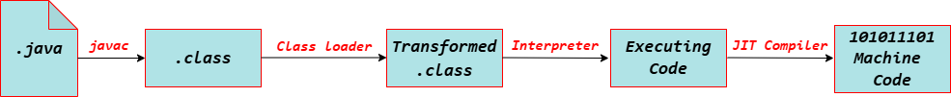
Interpreted
Java's interpreted feature means that Java code is not directly converted into machine code by a compiler. Instead, first, it compiled into bytecode, then executed by the JVM through an interpreter. It allows Java to be platform-independent, meaning the same bytecode can run on any system with a JVM.

Slide 17
Dynamic
Java is a dynamic language that supports the on-demand loading of classes. It also allows the use of functions from its native languages, namely C and C++.
Java supports dynamic compilation and automatic memory management, including garbage collection.

Slide 18
Open gedit text editor | gedit filename.java
New file | touch filename.java
To compile: | javac filename.java
To execute: | java filename

Slide 19
Example 1
public class Main{
public static void main(String args[]){
System.out.println("Hello, World!");
}
}

Slide 20
Example 2
public class Welcome {
public static void main(String[] args) {
System.out.println("Welcome to Java!");
}
}

Slide 21
Parameters used in First Java Program
class keyword is used to declare a class in Java.
public keyword is an access modifier that represents visibility. It means it is visible to all.
static is a keyword. If we declare any method as static, it is known as the static method. The core advantage of the static method is that there is no need to create an object to invoke the static method. The main() method is executed by the JVM, so it does not require creating an object to invoke the main() method. So, it saves memory.
void is the return type of the method. It means it does not return any value.
The main() method represents the starting point of the program.
String[] args or String args[] is used for command line argument. We will discuss it in coming section.
System.out.println() is used to print statement on the console. Here, System is a class, out is an object of the PrintStream class, println() is a method of the PrintStream class. We will discuss the internal working of System.out.println() statement in the coming section.

Slide 22
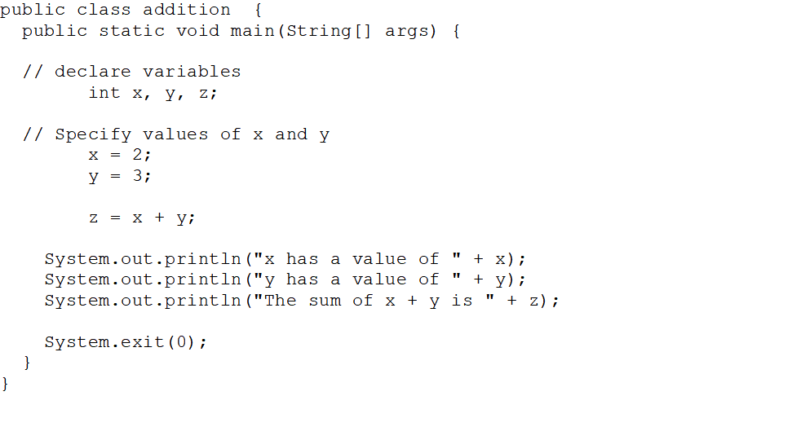
Example 3

Slide 23
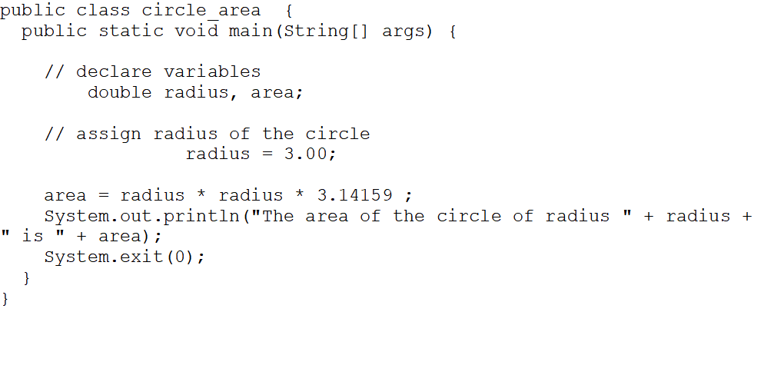
Example 4

Slide 24
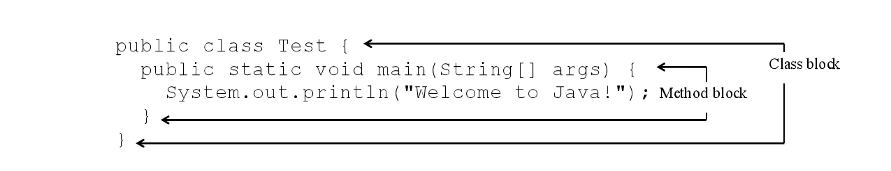
Blocks
A pair of braces in a program forms a block that groups components of a program.

Slide 25
Classes
The class is the essential Java construct. A class is a template or blueprint for objects.
A java program is defined by using one or more classes.

Slide 26
Methods
What is System.out.println?
It is a method: a collection of statements that performs a sequence of operations to display a message on the console.
It can be used even without fully understanding the details of how it works.
It is used by invoking a statement with a string argument. The string argument is enclosed within parentheses. In this case, the argument is "Welcome to Java!"
You can call the same println method with a different argument to print a different message.

Slide 27
main Method
The main method provides the control of program flow. The Java interpreter executes the application by invoking the main method.
The main method looks like this:
public static void main(String[] args) {

Slide 28
The exit Method
Use Exit to terminate the program and stop all threads.
When your program starts, a thread is spawned to run the program. To terminate the thread, you have to invoke the exit method.

Slide 29
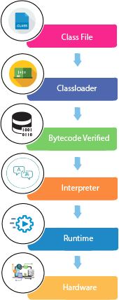
What happens at runtime?

Slide 30
JVM (Java Virtual Machine)
It is called a virtual machine because it doesn't physically exist. It is a specification that provides a runtime environment in which Java bytecode can be executed.
The JVM performs the following main tasks:
Loads code
Verifies code
Executes code
Provides runtime environment

Slide 31
JRE(Java Runtime Environment)
The Java Runtime Environment is a set of software tools that are used for developing Java applications.
It physically exists. It contains a set of libraries + other files that the JVM uses at runtime.

Slide 32
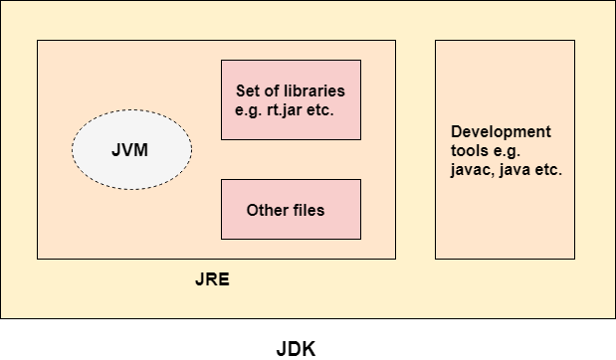
JDK(Java Development Kit)
It contains JRE + development tools.

Slide 33
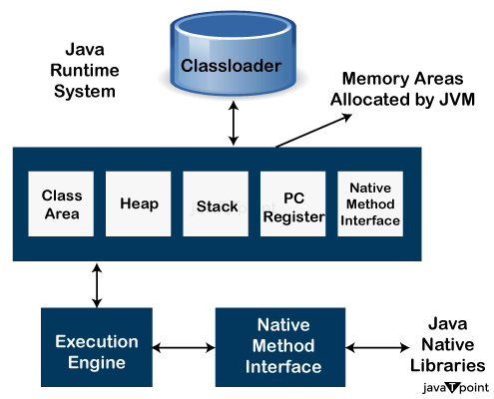
JVM Architecture

Slide 34
Variable
A variable is the name of a reserved area allocated in memory.
Types of Variables: There are three types of variables in Java:
local variable
instance variable
static variable

Slide 35
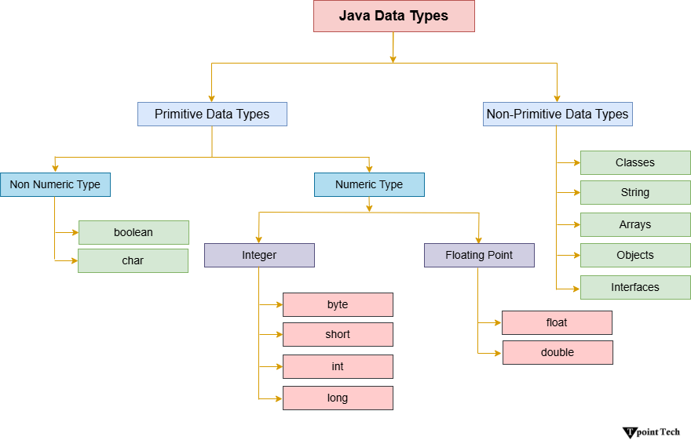
Data Types in Java

Slide 36
Java Operators
Here are mainly eight types of operators in Java:
Unary Operator
Arithmetic Operator
Relational Operator
Ternary Operator
Assignment Operator
Bitwise Operator
Logical Operator
Shift Operator

Slide 37
Anatomy of a Java Program
Comments
Reserved words
Modifiers
Statements
Blocks
Classes
Methods
The main method
The exit method

Slide 38
Comments
In Java, comments are preceded by two slashes (//) in a line, or enclosed between /* and */ in one or multiple lines. When the compiler sees //, it ignores all text after // in the same line. When it sees /*, it scans for the next */ and

Slide 39
Reserved Words
Reserved words or keywords are words that have a specific meaning to the compiler and cannot be used for other purposes in the program. For example, when the compiler sees the word class, it understands that the word after class is the name for the class. Other reserved words in Example 1.1 are public, static, and void.

Slide 40
Modifiers
Java uses certain reserved words called modifiers that specify the properties of the data, methods, and classes and how they can be used. Examples of modifiers are public and static. Other modifiers are private, final, abstract, and protected. A public datum, method, or class can be accessed by other programs. A private datum or method cannot be accessed by other programs.

Slide 41
Primitive Data Types and Operations
Introduce Programming with an Example
Identifiers, Variables, and Constants
Primitive Data Types
  byte, short, int, long, float, double, char, boolean
Expressions
Operators, Precedence, Associativity, Operand Evaluation Order: ++, --, *, /, %, +=, -=, *=, /=, %=, ^, &, |, +, -,
Getting Input from Input Dialog Boxes
Case Studies (Computing Mortgage, and Computing Changes)
Style and Documentation Guidelines
Syntax Errors, Runtime Errors, and Logic Errors

Slide 42
Identifiers
An identifier is a sequence of characters that consist of letters, digits, underscores (_), and dollar signs ($).
An identifier must start with a letter, an underscore (_), or a dollar sign ($). It cannot start with a digit.
An identifier cannot be a reserved word. (See Appendix A, “Java Keywords,” for a list of reserved words).
An identifier cannot be true, false, or
null.
An identifier can be of any length.

Slide 43
Declaring Variables
int x; // Declare x to be an
// integer variable;
double radius; // Declare radius to
// be a double variable;
char a; // Declare a to be a
// character variable;

Slide 44
Numerical Data Types (p.33)
byte 8 bits
short 16 bits
int 32 bits
long 64 bits
float 32 bits
double 64 bits

Slide 45
Type | Default Values | Size | Range of Values | Example
boolean | false | 8 bits | true, false | true, false, 0, 1
byte | 0 | 8 bits | -128 to 127 | -
char | \u0000 | 16 bits | Characters Representation of ASCII values 0 to 255 | 'z', '\u0041', '\11', '\\', '\', '\n'
short | 0 | 16 bits | -32,768 to 32,767 | -
int | 0 | 32 bits | -2,147,483,648 to 2,147,483,647 | -5,-1,0,6,8
long | 0 | 64 bits | -9,223,372,036,854,775,808 to 9,223,372,036,854,775,807 | -7L,-2L,0L,1L,2L
float | 0.0f | 32 bits | up to 7 decimal digits | 3.14f, 89.09F, -9.3F
double | 0.0 | 64 bits | up to 16 decimal digits | 6.98765e300d , -567899e-600d , 2e2d

Slide 46
Converting Strings to Integers
The input returned from the input dialog box is a string. If you enter a numeric value such as 123, it returns “123”. To obtain the input as a number, you have to convert a string into a number.
To convert a string into an int value, you can use the static parseInt method in the Integer class as follows:
int intValue = Integer.parseInt(intString);

Slide 47
Converting Strings to Doubles
To convert a string into a double value, you can use the static parseDouble method in the Double class as follows:
double doubleValue =Double.parseDouble(doubleString);
where doubleString is a numeric string such as “123.45”.

Slide 48
Appropriate Comments
Include a summary at the beginning of the program to explain what the program does, its key features, its supporting data structures, and any unique techniques it uses.
Include your name, class section, instruction, date, and a brief description at the beginning of the program.

Slide 49
Naming Conventions
Choose meaningful and descriptive names.
Variables and method names:
  Use lowercase. If the name consists of several words, concatenate all in one, use lowercase for the first word, and capitalize the first letter of each subsequent word in the name. For example, the variables radius and area, and the method computeArea.

Slide 50
Naming Conventions, cont.
Class names:
  Capitalize the first letter of each word in the name. For example, the class name ComputeArea.
Constants:
  Capitalize all letters in constants. For example, the constant PI.

Slide 51
Proper Indentation and Spacing
Indentation
  Indent two spaces.
Spacing
  Use blank line to separate segments of the code.

Slide 52
Programming Errors
Syntax Errors
  Detected by the compiler
Runtime Errors
  Causes the program to abort
Logic Errors
  Produces incorrect result

Slide 53
Compilation Errors
public class ShowSyntaxErrors {
public static void main(String[] args) {
i = 30
System.out.println(i+4);
}

Slide 54
Runtime Errors
public class ShowRuntimeErrors {
public static void main(String[] args) {
int i = 1 / 0;
}
}

Slide 55
Logic Errors
public class ShowLogicErrors {
// Determine if a number is between 1 and 100 inclusively
public static void main(String[] args) {
// Prompt the user to enter a number
String input = JOptionPane.showInputDialog(null,
"Please enter an integer:",
"ShowLogicErrors", JOptionPane.QUESTION_MESSAGE);
int number = Integer.parseInt(input);
// Display the result
System.out.println("The number is between 1 and 100, " +
"inclusively? " + ((1 < number) && (number < 100)));

